Slide 1



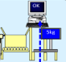
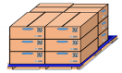







OQC Visualize System - Concept
1/6
1
Pick up Sample
OQC Inspection
Chop Physical Stamp
Shipment
OQC manual control when picking up samples
No indicate shipment priority
Quality issues/ 4M alert at only Production
Manual control weight check
Update OQC result not timely
Each step independent, easy to skip process
Manual make Daily report
OQC: Loss time to find and chop stamp
FA: Manual check stamp to create Pallet ID
SCM: Manual to confirm OQC inspection result to input WMS
CURRENT
Visualization data
OQC inspection
Shipment
Software
Weight check
Pick up sample
3
Auto Judgement
1
2
Verify OQC
judgment
NEW SYSTEM
OQC Weight check online
OQC Inspection
WMS
system
Return sample
Verify OQC judgment
PEMS
system
Create Pallet ID
Transfer to SCM
Shrink machine
SCM warehouse
Indicates S/N OQC pick up
Indicate shipment priority
Quality issues/4M change indicate on OQC system
Indicate OQC & Lot judgment
Eliminate manual job OQC
➔ Save: 1,000H/year
E-chop and indication on system
➔ OQC: ∆2pax
Visualize status model following shipment plan
Link final confirmation to WMS/PDA
AFTER

Slide 2

OQC Visualize System
2/6
Details of system Production → OQC
IN
OUT
Weight check system
Pallet ID
4M/ Quality information
Production
OQC
OQC result update timely
Visualize lot judgment from system
◆Before
◆ After
OQC:
Not link weight system → OQC Manual control
Manual check Production Plan
Manual update OQC result & make daily OQC report
Manual go to SCM warehouse
Production:
Manual confirm OQC result to transfer to ID pallet
OQC:
Link with weight check & PEMS about Quality
Auto indicate shipment priority → Priority inspection
Auto link to OQC check sheet after reading barcode
Auto update OQC result timely & export daily report
Production:
Visualize and check OQC judgment by PDA
Verify OQC judgment by system before transfer SCM
PEM
System
Link
No Link
No Link
Link
PEM
System
Link
OQC
Weight check
OQC
Pallet ID
OQC
Weight check
Link
OQC
Insp
Link
Pallet ID
All concern sections manual control & communication
→ Take time (FA/OQC/SCM)
E chop and visualize OQC Judgment form system
→ Saving time OQC / FA/ SCM

Slide 3
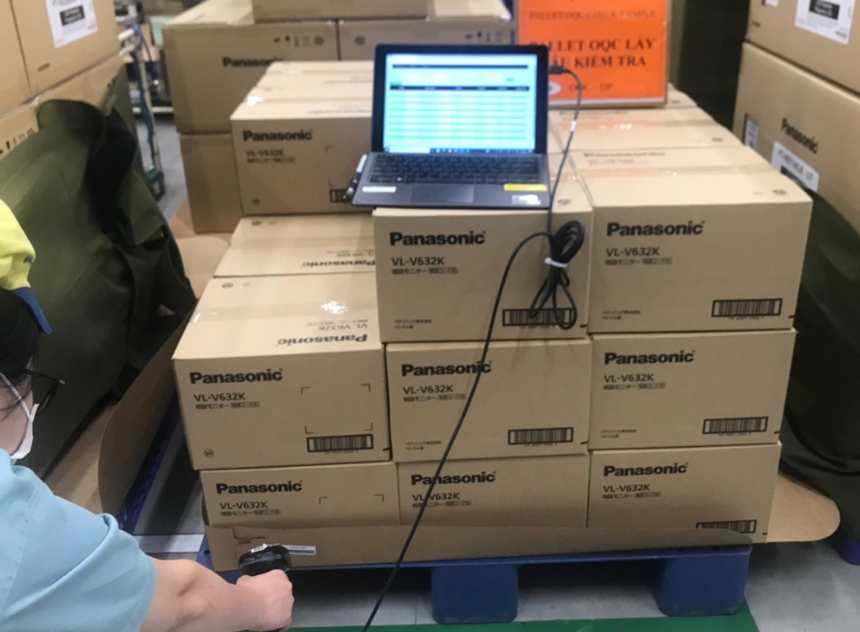
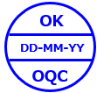
OQC Visualize System
3/6
Details of system OQC → SCM
Judgment lot
OQC
SCM
OQC result update
Auto judgment lot
◆Before
◆ After
OQC:
Manual counting quantity each lot
Manual searching keeping area at warehouse
Manual confirm chop physical stamp
OK judgment indication by OK/NG board
SCM
Manual confirm OQC checking status
( Message/ Phone )
Confirm Lot judgment by Indication board & stamp
OQC
No need counting and searching F/G area
Auto update lot judgment by e-chop ( △2pax)
Indicate Lot Judgment on system and visualize at FA/ SCM
SCM:
Auto indicate confirmation status of model on WMS
Check OQC judgment by PDA
Visualize shipment on WMS

Slide 4


















Project Members
4/6
Organization of Project:
Member: IT/QC/FA/SCM
ADVISOR
IT
OQC
FA
SCM
Hien
Minh
Tu
Tung
Tho
Huong
Linh
Cuong
Project Manager
Project Leader
Member
Member
Member

Slide 5


OQC Visualize System
Procurement activity
5/6
Equipment list require
Section | Name Equipment | Image | Function | Quantity
OQC | Tablet windows (Connect with barcode reader) or PDA |  | 1.1, Pick up sample 1.2, Return Sample 1.3, Find quickly Pallet ID and Model at FA & SCM area 1.4, Visualize OQC inspection with FA, SCM | 3 (FA transfer)
FA | PDA |  | 2.1, Verify OQC judgment 2.2, Check the status of OQC inspection | 3 (FA consider)
ROI
Total Investment ($) | Efficiency/M ($) | Efficiency/Y ($) | ROI /Y
1,800 | 1,085 | 13,020 | 0.13824

Slide 6
OQC Visualize System
6/6
Project Schedule
Plan
Actual
Go-live
Group Function | Department | Aug.24 | Sep.24 | Oct.24 | Nov.24 | Dec.24 | Jan.25 | Feb.25 | Mar.25
Meeting, discuss, analyze | SCM/QC/FA/IT
Standardize processing | SCM/QC/FA/IT
Weight check online OQC(1) | QC/IT
OQC inspection & judgment all lots(2) | SCM/QC/FA/IT
Visualize inspection result OQC(3) | SCM/QC/FA/IT
SIT, UAT & go-live | QC/IT

Slide 7
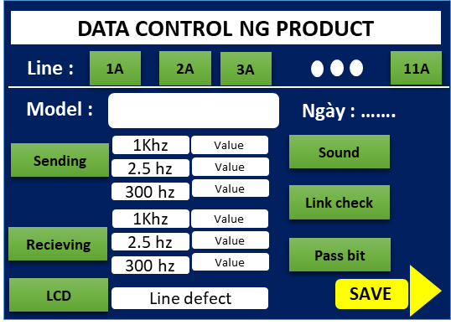
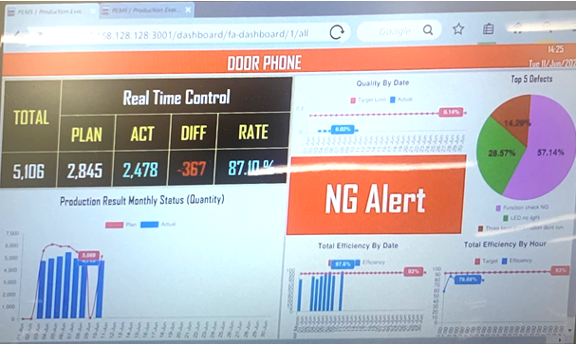



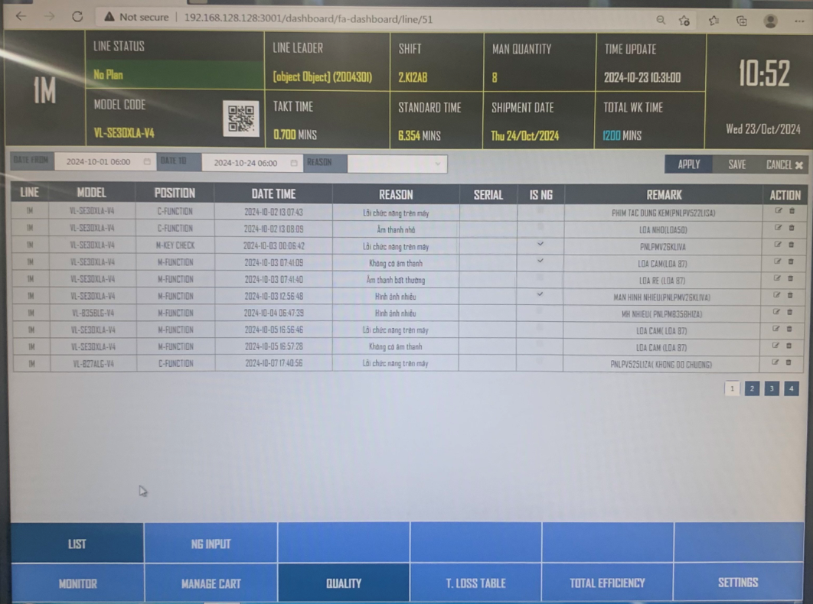
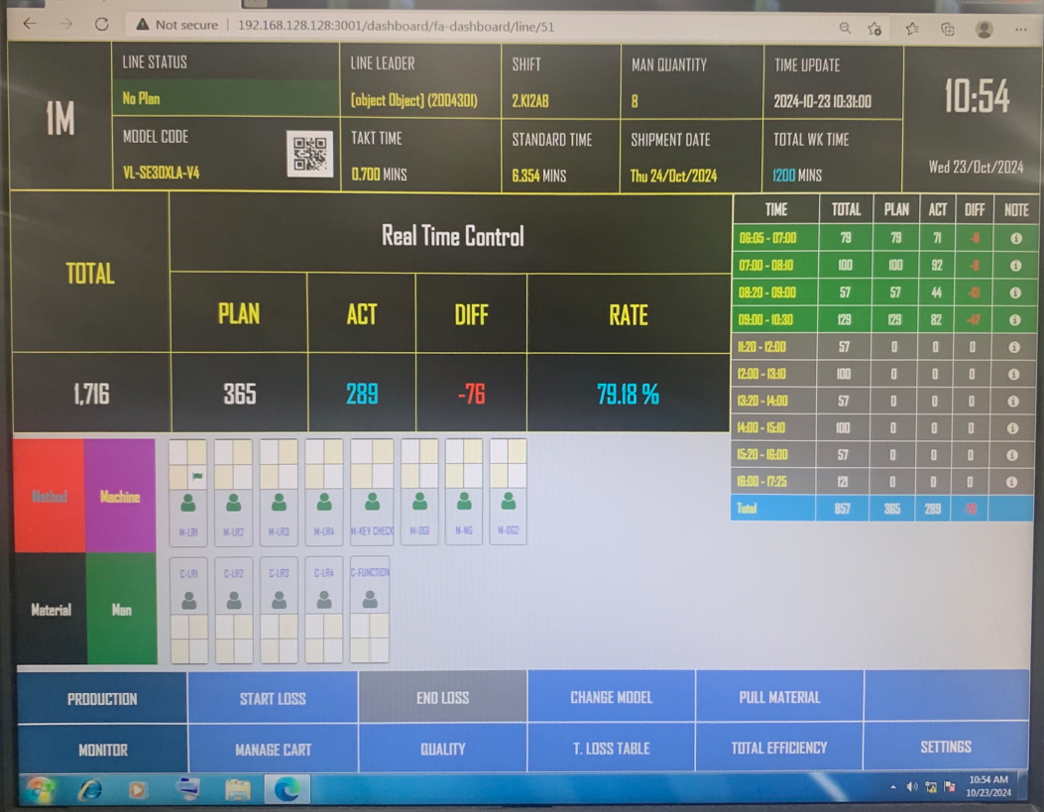
Develop defect control System
Review current Quality Issue in PEMS system
Current situation
System visualize quality situation on process only
Quality issue
PEM
System
Improvement for Quality function in PEMS system: Link PEMS system with OQC system
<FA line >
Indicate Quality status of lot
Indicate add action request
Input all
Quality issues
Link
OQC
INSP
PEMS Server
- Quality Issue
PEMS alarm defect as below rule:
PL/ Wrong Part/ Missing part
Happen on over 3 products
Repeat happen at Process
4M change
Timely indicate process Quality to act
Add or focus check point to ensure quality
Lot Judgment consideration
Trace back if Market issue
Link to OQC system
*Confirmation: OQC reading Serial No
If process quality happen , Supervisor above required to confirm next action
Defect issue
4M change
Purpose : Focus defect to take more action / Judgment for Lot/ Trace back for Market issue

Slide 8

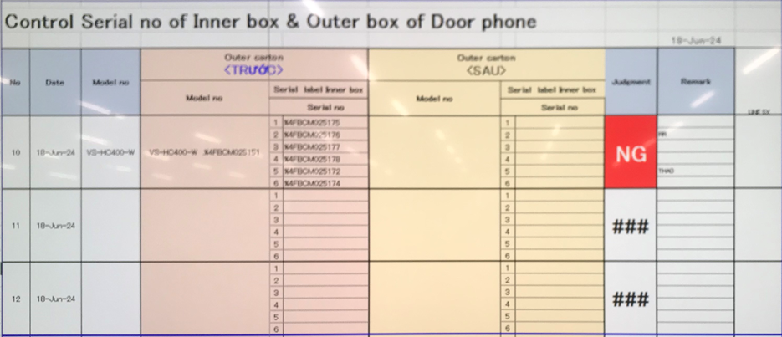
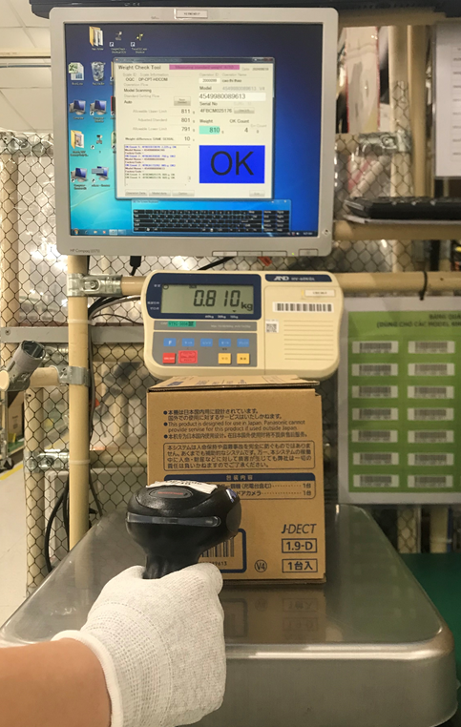
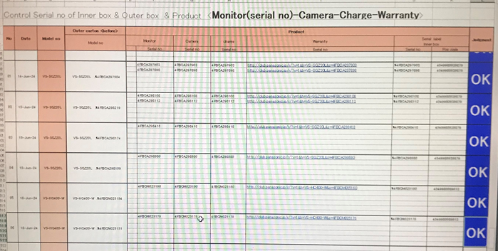
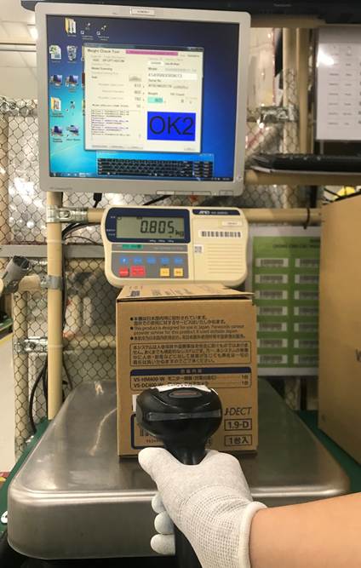
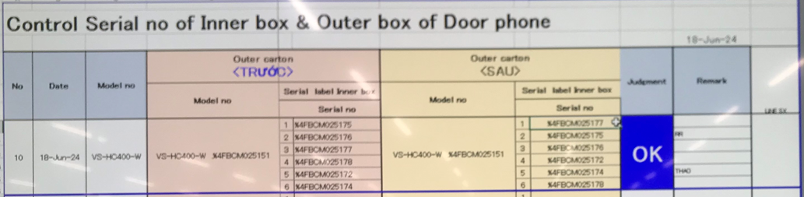


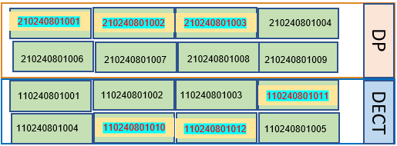
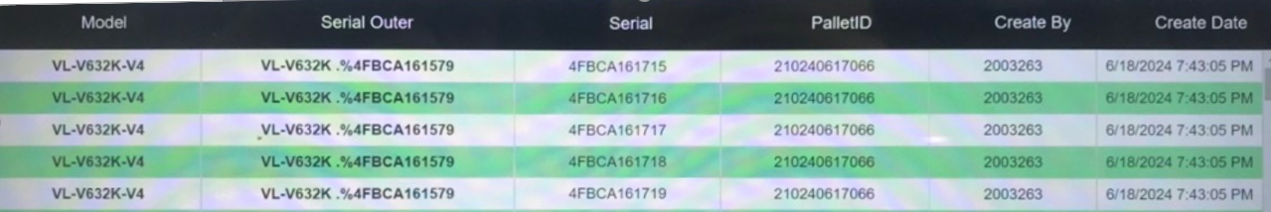
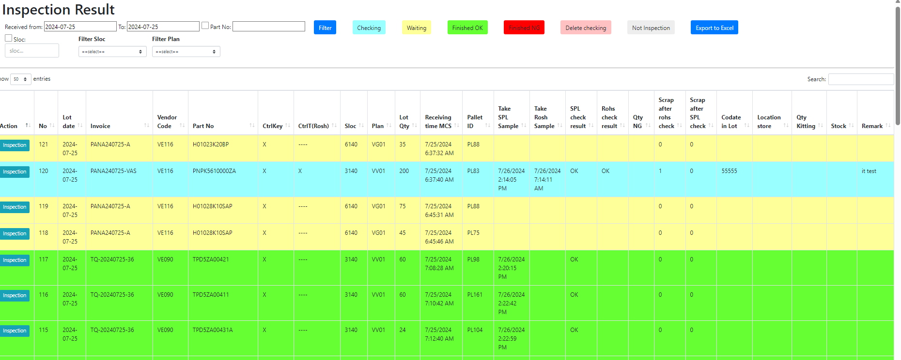
OQC Visualize System
Current situation OQC
Pick up sample
Reading barcode Inner/Outer excel file
Weight check 1st
OQC
inspection
Reading BC
Product/Inner excel file
Weight check 2nd
Reading barcode
Inner/Outer excel file
Return sample
No Link
No Link
3
No Link
Reliability
No Link
5
No Link
6
No Link
7
No Link
8
1
2
4
Production Line
Confirm S/N Outer & all inner boxes
Accessory control
Numbering control & Separate area
Product/Warranty/Manual & Inner box
Accessory control
Confirm S/N Outer & all inner boxes
Warehouse FA
Improvement
Software
Software
Software
1
2
3
4
5
6
7
8
Auto link weight FA
Auto link weight FA
Database server OQC
<Judgment Lot>
Before
E – chop replace physical stamp
After
Visualize FA-SCM W/H
Manual find pallet
<Physical stamp>

